Slide 1
HOTEL BOOKING DEMAND
Andrew Tawdros Sec: 1 BN: 14
Mark Medhat Sec: 2 BN: 12

Slide 2
CONTENTS
OBJECTIVE
ANALYTICAL OVERVIEW
TIME SERIES ANALYSIS
PREDICT CANCELLATION
MODEL COMPARISIONS
Business point of view
EXPLORATORY DATA ANALYSIS

Slide 3
OBJECTIVE
The cancellation rate for booking hotels online is high that creates discomfort for many hotels and create a desire to take precautions. Therefore, predicting reservations that can be cancelled will create a surplus value for hotels and hotels can take action to prevent these cancellations.

Slide 4
ANALYTICAL OVERVIEW
Analyze the data
Data Pre-Processing and Data Cleaning
Data visualization
Testing the model accuracy
Model/classifier
Extracting the insights

Slide 5
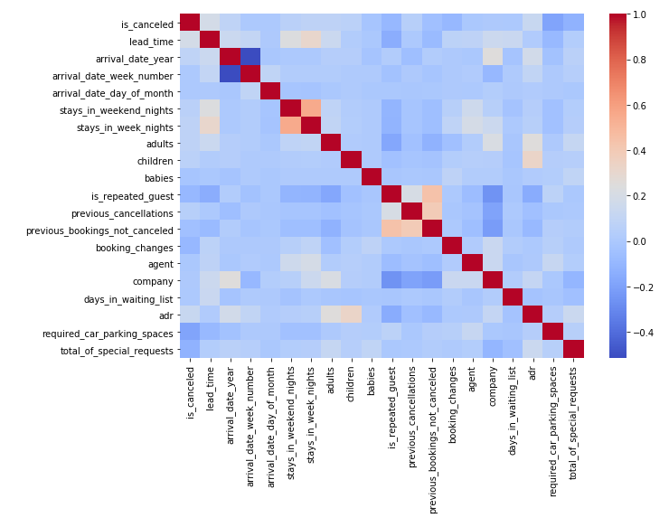
EXPLORATORY DATA ANALYSIS
“Correlation matrix used to explore the correlation between the data”

Slide 6
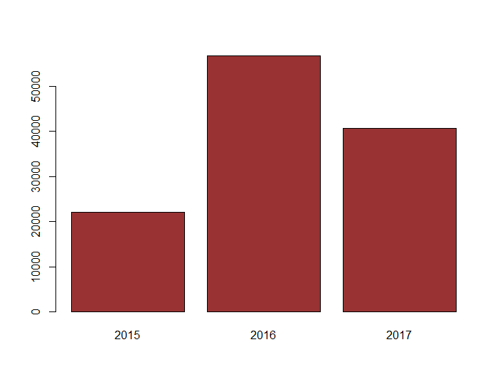
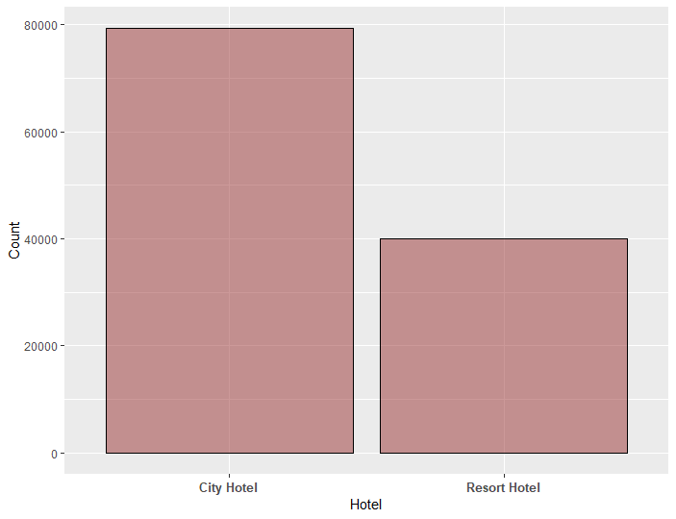
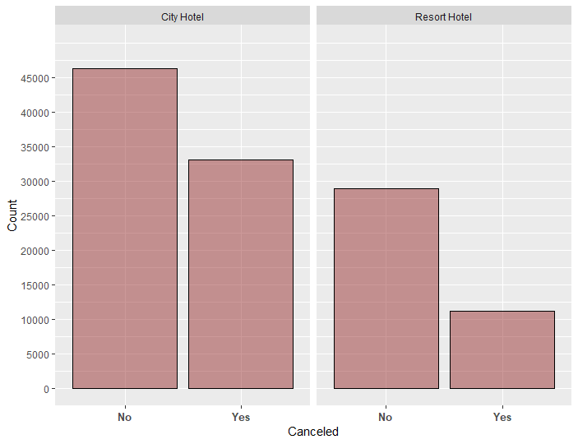
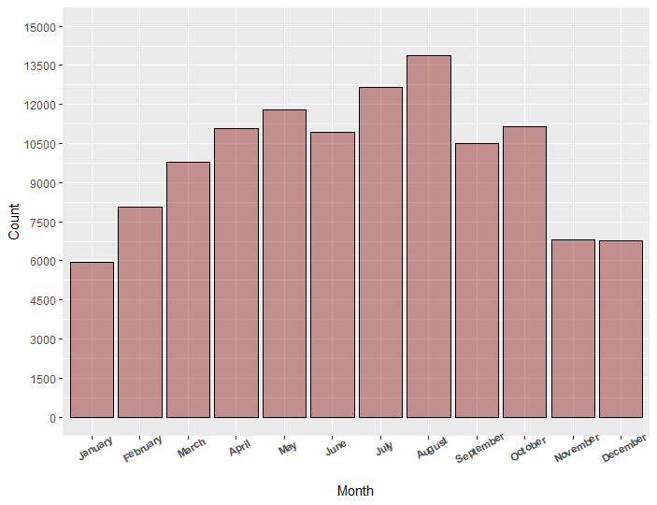
EXPLORATORY DATA ANALYSIS
No. of arrivals per year
City hotels vs Resort hotels
Number of city hotel and Resort Hotel cancelled or not cancelled
Number of arrival Date by Month
Notes:
Highest Bookings in the month of July and August and lowest in January.
City Hotel Cancellation is more
Chances of cancellations are less when the lead time of booking is less.
May and October have the highest waiting times
Online market segment's cancellation is more
'A' type room cancellation is higher
Couples booking cancellation is more

Slide 7
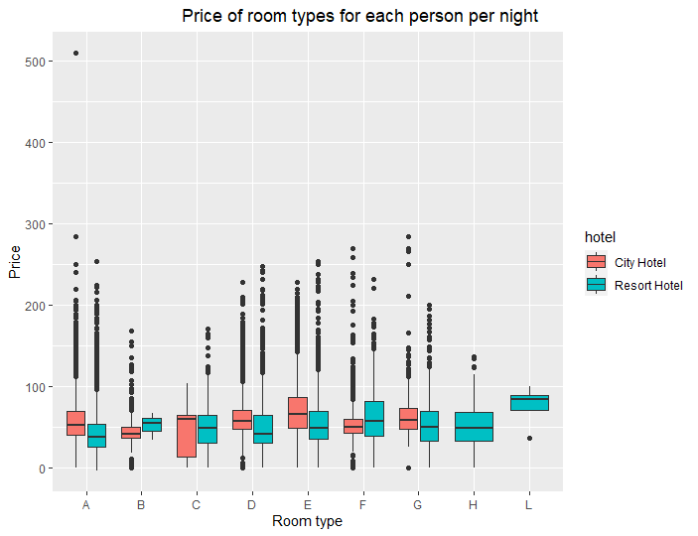
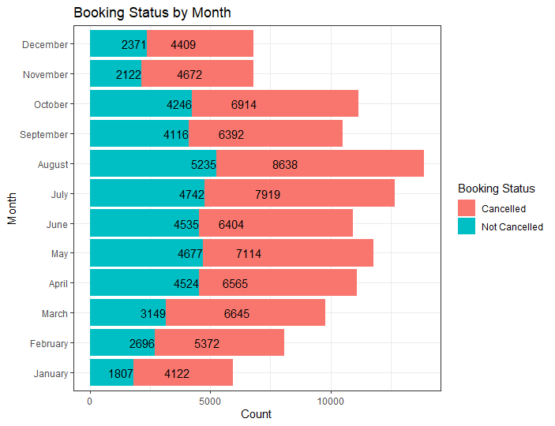
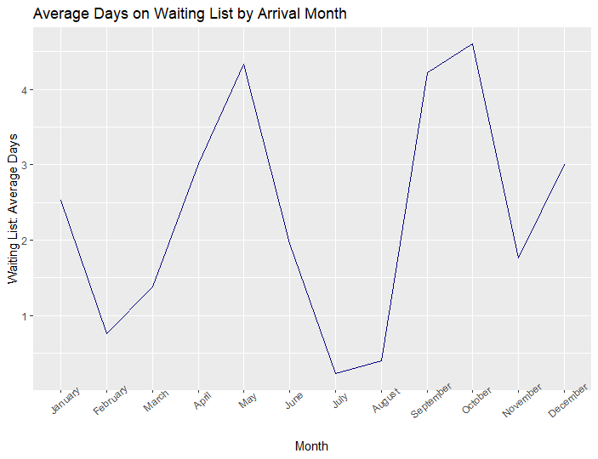
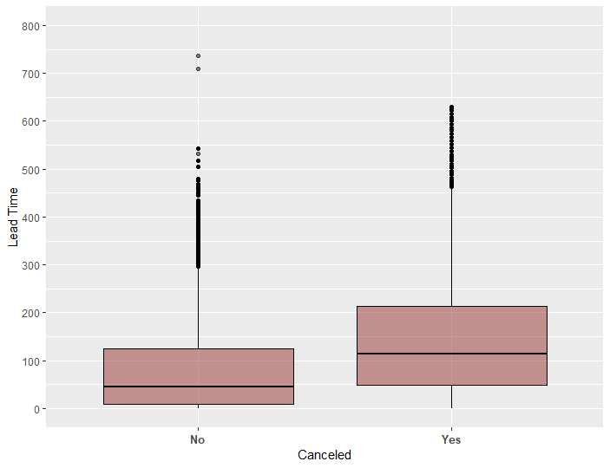
EXPLORATORY DATA ANALYSIS
Price of (cancelled) room types for each person per night
Cancellation per month
Waiting list per month
Lead time w.r.t. Cancellation

Slide 8
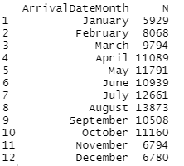
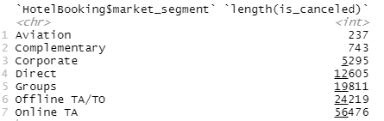

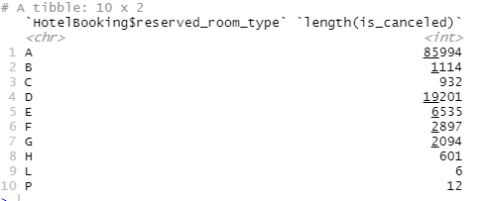
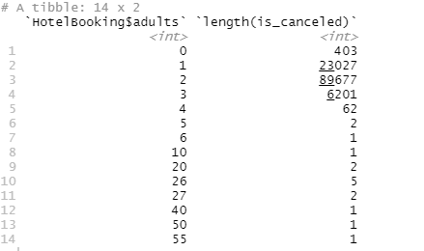
EXPLORATORY DATA ANALYSIS [Insights]
Highest Bookings in the month of July and August and lowest in January
Online market segment's cancellation is more
City Hotel Cancellation is more
'A' type room cancellation is higher
Couples booking cancellation is more
Notes:
1.Highest Bookings in the month of July and August and lowest in January.
2. City Hotel Cancellation is more
3. Chances of cancellations are less when the lead time of booking is less.
4. May and October have the highest waiting times
5. Online market segment's cancellation is more
6. 'A' type room cancellation is higher
7. Couples booking cancellation is more

Slide 9
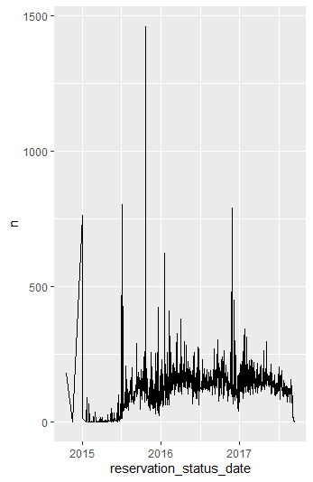
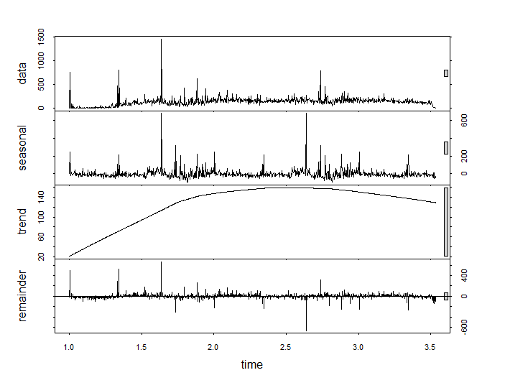
TIME SERIES ANALYSIS

Slide 10
PREDICT CANCELLATION
The dataset was split with ratio 70:30
We have used two classifiers which are:
Logistic regression
Random Forest
Finally, Random Forest was considered

Slide 11
MODEL COMPARISIONS
Models Accuracies | Random Forest | Logistic Regression
TestSet Accuracy | 84.2% | 83.3%

Slide 12
Business point of view
Booking cancellation model makes it possible for management to avoid potential cancellations with strategies such as discounts or other perks.
The prediction model helps to mitigate revenue loss and the risks associated with overbooking.
The audiences of the project are the hotels that want to allocate resources reasonably according to the cancellation rate of bookings during peak seasons, or the hotels that want to find out which factors cause booking cancelation. They can make improvements to these factors.
For Future work, we can answer these questions:
- Q1. when is the best time of year to book a hotel room?
- Q2. What if you want to predict whether or not a hotel is likely to receive a huge number of special requests?

